Slide 1
A Real-Time Environmental Monitoring System
By :- Pankaj Bhusal, Sakshi Ojha, Udayy Singh Pawar

Slide 2
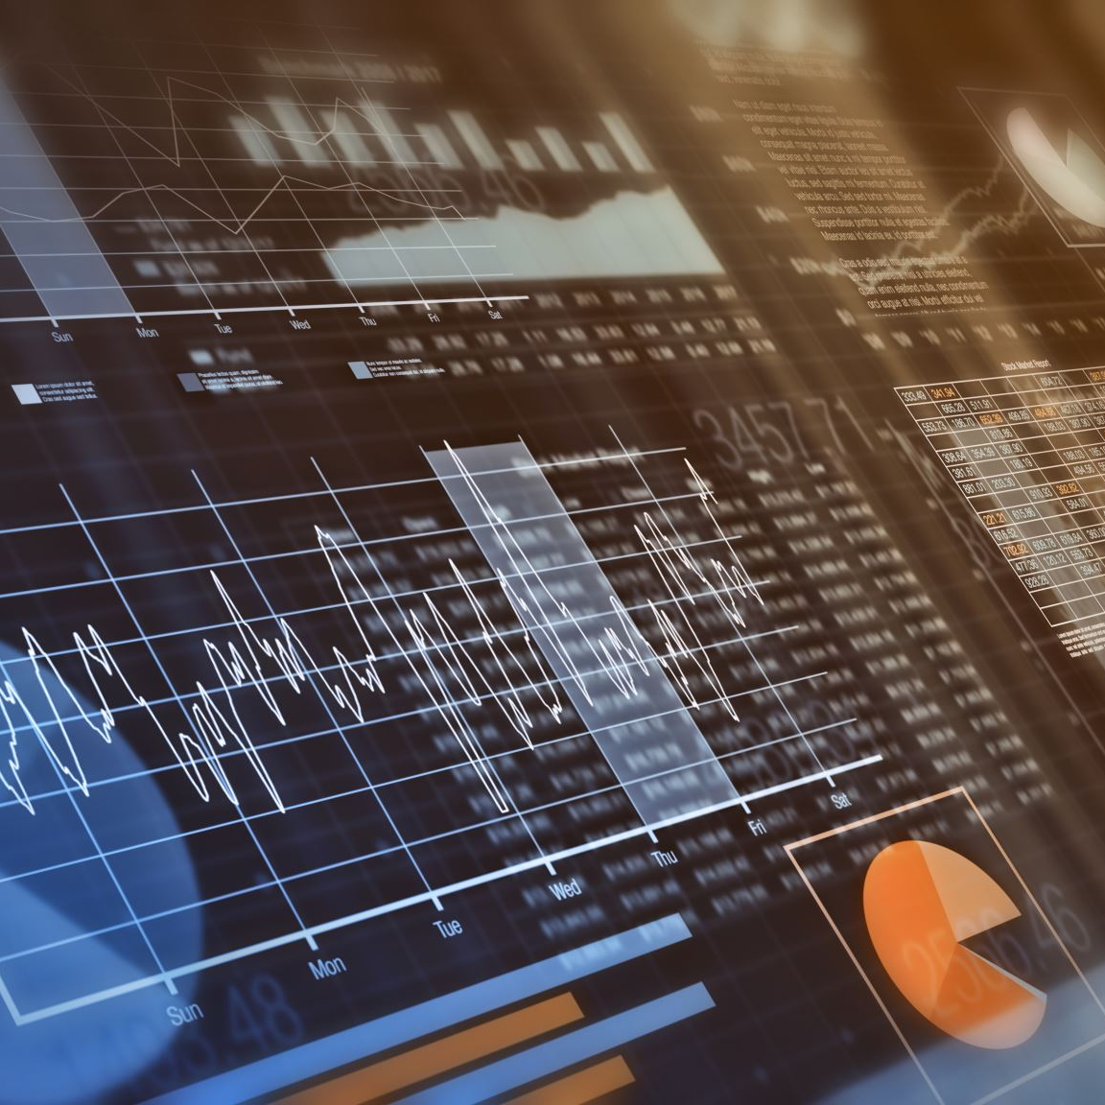
Overview of the Project:
Our project focuses on developing a real-time environmental monitoring system using a combination of various sensors and the ThingSpeak platform. This system aims to collect and analyze data related to gas levels, temperature, humidity, and CO2 concentration in the environment. The collected data is visualized on ThingSpeak, enabling users to monitor the environmental conditions remotely.

Slide 3

Objectives and Goals:
Real-Time Data Collection:
Implement sensors to collect data on gas levels, temperature, humidity, and CO2 concentration continuously.
Data Visualization:
Utilize the ThingSpeak platform to visualize the collected data in an intuitive and accessible manner.
User Alerts and Notifications:
Integrate alert mechanisms such as buzzers and LEDs to notify users of significant changes in real-time.
System Robustness:
Reliable operation with thorough testing and issue resolution.
User-Friendly Interface:
Clear and descriptive data visualizations with labels and legends.
Scalability and Future Integration:
Expandable design for future sensor additions and enhanced monitoring capabilities.

Slide 4
System Architecture
Hardware Components
Software Components
Sensors
Gas Sensor(MQ2-gas Sensor)
DHT11 Temperature and humidity Sensor
Co2 Sensor(MH-Z19B)
Key Hardware
RaspberryPi
Leds and buzzer for Alerts
Jumper wires and Breadboard
Python:
For data collection and handling
RealVNC Viewer:
For editing and running code files
ThingSpeak:
For Data visualization and cloud integration

Slide 5
System Architecture: Two Tier
Data Acquisition Layer (DAL)
Data Transmission Layer (DTL):
Resides on the Raspberry Pi, sensors are connected to the raspberry pi via breadboard
Handles sensor data reading from various sensors connected to the Raspberry Pi (DHT11, CO2 sensor, MQ2 gas sensor)
Performs basic data processing (e.g., unit conversions).
Triggers alerts (e.g., buzzer activation) if sensor readings exceed pre-defined thresholds.
Constructs a dictionary containing sensor data for transmission.
Resides on the Raspberry Pi
Utilizes the Thingspeak library to transmit the sensor data dictionary (constructed in the DAL) to a ThingSpeak channel via the internet connection on the Raspberry Pi.

Slide 6
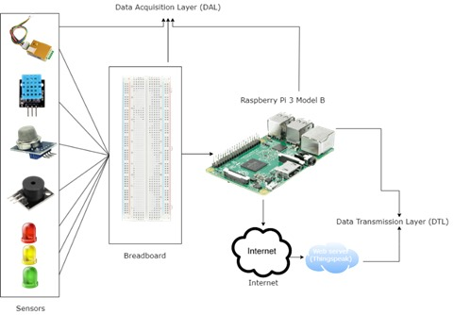
System Architecture: Two Tier

Slide 7
Implementation Details
Sensor Integrations:
ThingSpeak Integration:
Connections:
Gas Sensor: Connected via GPIO pin 12
DHT11: Connected via GPIO pin 16
CO2 Sensor (MH-Z19B): Connected via UART
Data Reading:
Gas Sensor: Digital input for gas detection
DHT11: Temperature and humidity readings
CO2 Sensor: CO2 concentration levels
Code Overview:
Python scripts for initializing sensors
Continuous data reading and processing
Alert system with LEDs and buzzer
Data Transmission:
Periodic data upload to ThingSpeak
HTTP POST requests using ThingSpeak API
API Configuration:
API Key:“0RH3YYBQLXAGHXHY” and Channel is public
Data field mapping for temperature, humidity, gas, and
CO2 levels

Slide 8
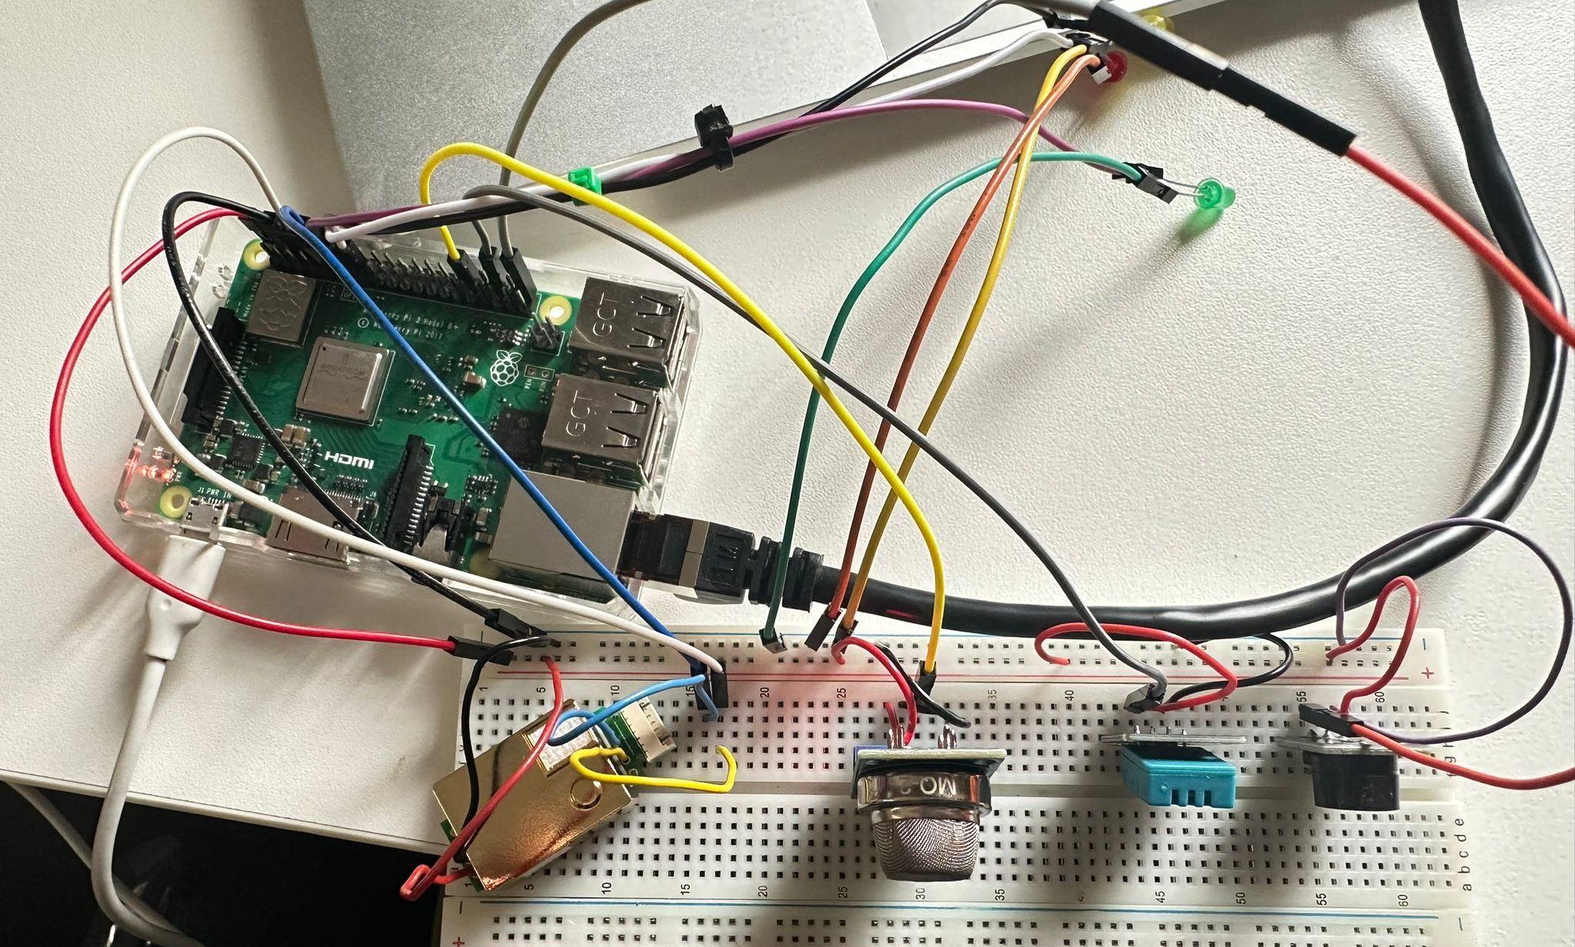
Integration of All sensors

Slide 9
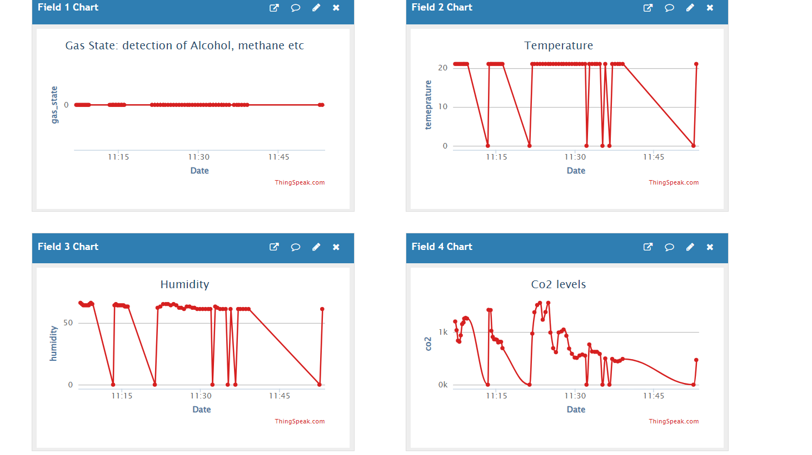
Data Visualization and Alerts
Real-Time Alerts:
Alert Mechanisms:
Buzzers and LEDs integrated for immediate alerts.
Trigger Conditions:
High temperature: Buzzer sound
Poor air quality: Red LED indicator
Gas detection: Immediate change in graph and sensor light changes to green

Slide 10
Testing and Evaluation
Testing Process:
Methods:
Collected feedback for usability insights.
Conducted stress testing to ensure system stability under load.
Test Cases and Results:
Example: Simulated high CO2 levels to test alert accuracy.
Result: Buzzer and red LED activated correctly.
Evaluation:
Performance Metrics:
Response time of sensors.
Accuracy of data logging and alerts.
Issues and Resolutions:
Initial delay in data transmission to ThingSpeak.
Resolved by optimizing API request handling.

Slide 11
Results and Discussion
Summary of Results:
The testing phase revealed robust performance metrics, showcasing the reliability and accuracy of our air quality monitoring system.
Data collected from various sensors provided comprehensive insights into environmental conditions, enabling informed decision-making.
User Experience Improvements:
Incorporating user feedback has led to significant enhancements in system usability and interface design.
Streamlined navigation and intuitive features have enhanced user engagement and satisfaction.

Slide 12
Conclusion:
In conclusion, our air quality monitoring project has successfully achieved its objectives of providing real-time insights into environmental conditions. Through the integration of various sensors and the utilization of a cloud platform for data visualization, we have created a robust system capable of monitoring key air quality parameters.
Looking ahead, there is immense potential for further enhancements and applications of our air quality monitoring system. Future iterations could incorporate advanced sensor technologies, expand the geographical coverage, and integrate with public health initiatives. Ultimately, our project lays the foundation for addressing air quality challenges and fostering sustainable urban development.

Slide 13
Questions?

